Slide 1
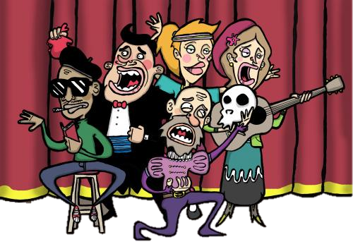
Elements of Drama

Slide 2
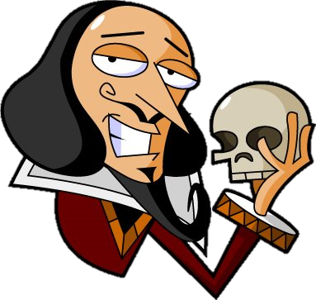
What is Drama?
A play is a story acted out, live and onstage.

Slide 3
Structure of a Drama
Like the plot of a story, the plot of a drama follows a rising-and-falling structure.
Climax
tension at highest point
Complications
tension builds
Resolution
conflict is settled, play ends
Exposition conflict is introduced

Slide 4
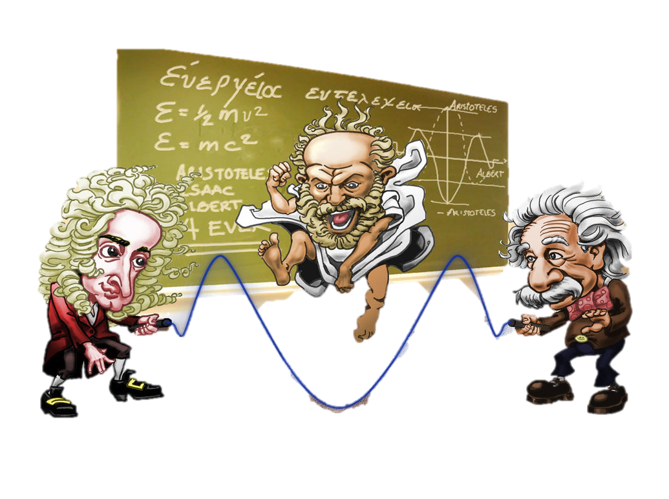
Aristotle
Aristotle (384-322 BC) was a Greek philosopher whose writings still influence us today. He was the first to write about the essential elements of drama more than 2,000 years ago. While ideas have changed slightly over the years, we still
discuss Aristotle's list when
talking about what makes
the best drama.

Slide 5
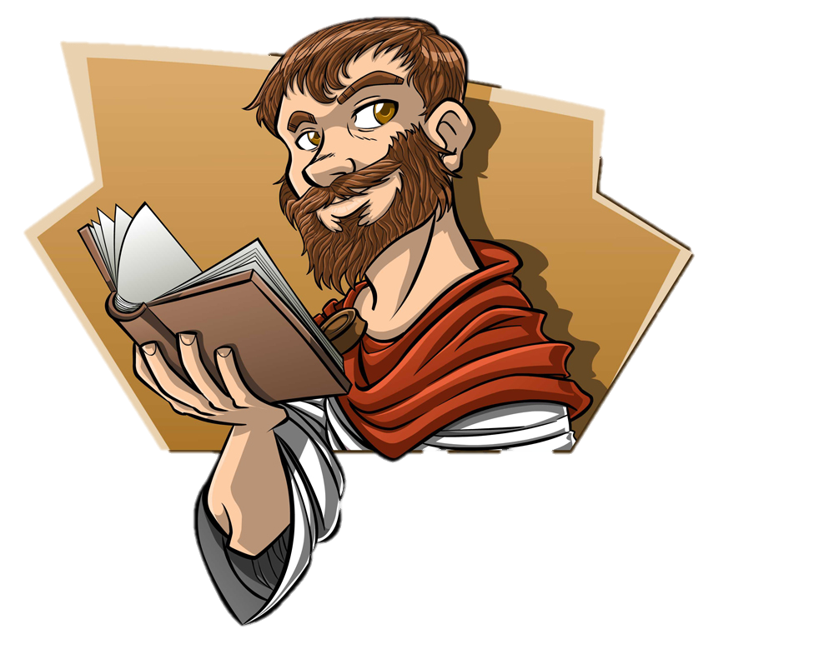
Aristotle considered these six things
to be essential to good drama:
Plot
Theme
Characters
Dialogue
Music/Rhythm
Spectacle
Notes:
Plot: This is what happens in the play. Plot refers to the action;
the basic storyline of the play.
• Theme: While plot refers to the action of the play, theme refers
to the meaning of the play. Theme is the main idea or lesson
to be learned from the play. In some cases, the theme
of a play is obvious; other times it is quite subtle.
• Characters: Characters are the people (sometimes animals or ideas)
portrayed by the actors in the play. It is the characters who move the action,
or plot, of the play forward.
• Dialogue: This refers to the words written by the playwright and spoken
by the characters in the play. The dialogue helps move the action of the play along.
• Music/Rhythm: While music is often featured in drama, in this case Aristotle
was referring to the rhythm of the actors' voices as they speak.
• Spectacle: This refers to the visual elements of a play: sets, costumes, special effects,
etc. Spectacle is everything that the audience sees as they watch the play.

Slide 6
Modern Theater
The list of essential elements in modern theater is as follows:
• Characters
• Plot
• Theme
• Dialogue
• Convention
• Genre
• Audience
Notes:
In the modern theater, this list has changed slightly, although you will notice
that many of the elements remain the same.
Convention: These are the techniques and methods
used by the playwright and director to create the desired stylistic effect.
• Genre: Genre refers to the type of play. Some examples of different genres
include comedy, tragedy, mystery and historical play.
• Audience: This is the group of people who watch the play. Many playwrights and
actors consider the audience to be the most important element of drama, as all of
the effort put in to writing and producing a play is for the enjoyment of the audience.

Slide 7
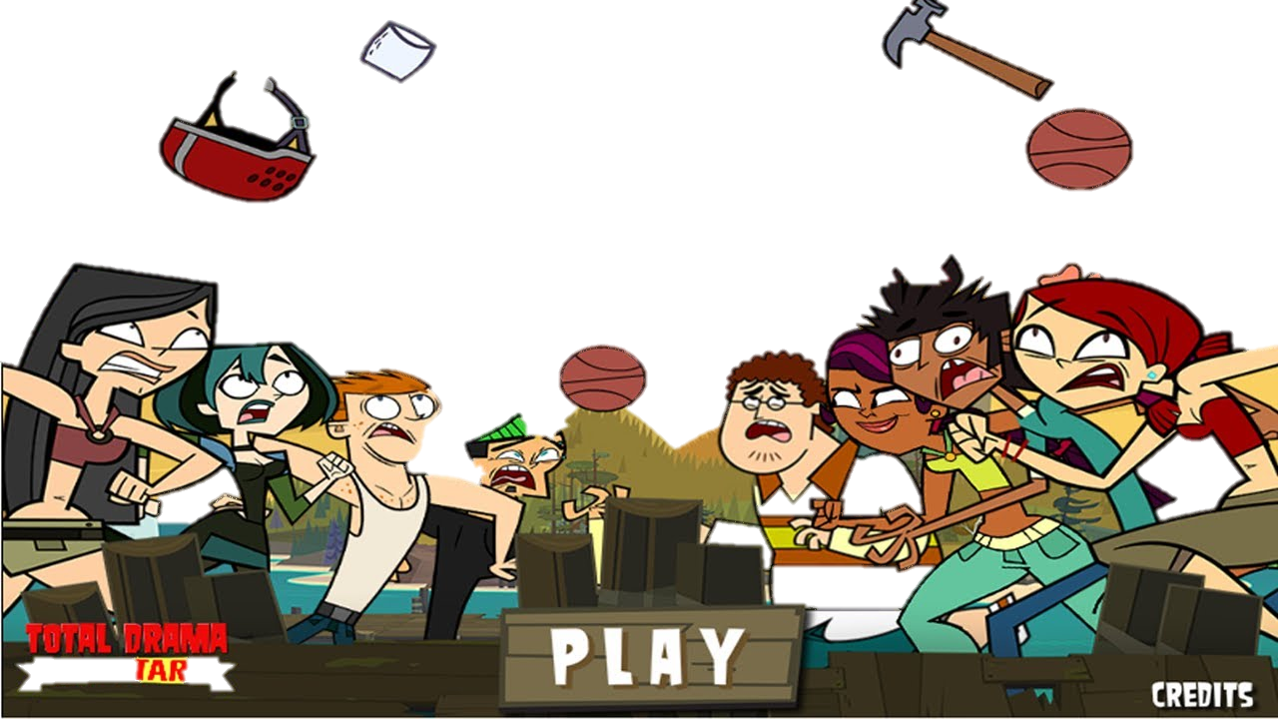
Three Major Elements
Literary elements
Technical elements
Performance elements
Notes:
The elements of drama, by which
dramatic works can be analyzed and evaluated
into three major areas:

Slide 8
Literary Elements
Exposition: “who, when, where and what”
Initial incident: “gets the story going”
Preliminary event: Whatever takes place BEFORE the action
Conflict: struggle between opposing forces, ideas, or interests
Climax: The turning point or high point of a story.
Suspense: A feeling of uncertainty as to the outcome, used to build interest and excitement on the part of the audience
Rising action: following the initial incident and leading up to the dramatic climax
Falling action: The series of events following the climax
Denouement: Sudden drop
Notes:
Exposition: The “who, when, where and what” part of the play
Initial incident: The event that “gets the story going”
Preliminary event: Whatever takes place BEFORE the
action of the play that is directly related to the play
Conflict: The internal or external struggle
between opposing forces,
ideas, or interests that creates
dramatic tension Conflict creates
both expectation and anxiety about
the ending, necessary for dramatic tension
Climax: The turning point or high point of
a story, when events can go either way
Suspense: A feeling of uncertainty as to the outcome,
used to build interest and excitement on the part of the audience
Rising action: A series of events following the initial incident
and leading up to the dramatic climax
Falling action: The series of events following the climax
Denouement: Another term for the conclusion from the
French word for “unraveling”

Slide 9
Technical Elements
Scenery (set): theatrical equipment used in a dramatic production
Costumes: Clothing and accessories worn by actors
Props: Short for properties
Lights: to help communicate environment, mood, or feeling
Sound: The effects an audience hears during performance
Makeup: Costumes, wigs, and body paint used.
Notes:
Scenery (set): The theatrical equipment, such as curtains, flats, backdrops,
or platforms, used in a dramatic production to communicate environment
Costumes: Clothing and accessories worn by actors
to portray character and period.
Props: Short for properties; any article, except costume or scenery, used
as part of a dramatic production; any moveable object that appears
on stage during a performance, from a telephone to a train
Lights: to help communicate environment, mood, or feeling
Sound: The effects an audience hears during performance
to communicate character, context, or environment
Makeup: Costumes, wigs, and body paint used to transform
an actor into a character.

Slide 10
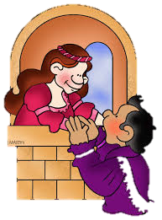
Performance Elements
Acting: Use of face, body, and voice to portray character
Character analysis: examining how the elements of drama are used
Empathy: The capacity to relate to the feelings of another
Speaking: The mode of expression or delivery of lines
Breath control: Proper use of the lungs and diaphragm muscle.
Vocal expression: How an actor uses his or her voice
Inflection: Change in pitch or loudness of the voice.
Projection: How well the voice carries to the audience
Speaking style: The mode of expression or delivery of lines
Diction: Selection and pronunciation of words; clarity of speech.
Gestures: movement of the actor’s body to convey meaning
Facial expression: Physical and vocal aspects used by an actor

Slide 11
The World Is an Apple
By: Alberto Florentino
Notes:
Alberto Florentino is a Filipino playwright and publisher.
His plays in English center
on conflicts in the everyday lives of Filipinos.
The most famous of his works is The World is an Apple.

Slide 12
Plot
Mario and Gloria has no money to buy food for their daughter. Mario lost his job for stealing an apple. Falsely figuring out the situation as misfortune he left his wife and daughter, went back to his partner in crime Pablo and did crimes again to have money.
Character
Mario – the man who lost his job.
Gloria – wife
Pablo – the crime buddy of Mario.
Tita – daughter
Exposition
Mario enters from the street at left. He is in the late twenties shabbily dressed and with hair that seems to have been uncut for weeks. Gloria greeted him and then Mario asked about the condition of their child
Notes:
setting for the drama establishes the emotional atmosphere, or mood, for the story.
Keep in mind that the setting constitutes more than the physical characteristics of the
set, such as the way a room is decorated or how the furniture is arranged.
It also includes the historical and cultural moment in which the story takes place,
or its social context.
Marios and Pablos character is flat/static because bad guys in the end are still bad.

Slide 13
Setting
House – two wooden boxes flank the doorway. At left is an Acacia tree with wooden bench under it.
Conflict
Man vs. Self - Internal Conflict
Rising Action
Mario started to elaborate his reasons why he doesn’t have money.
Climax
Mario confessed that he lost his job because of stealing an apple

Slide 14
Falling Action
Mario revealed the reason why he stole an apple and that he’s planning to apply as a night watchman in a company.
Denouement
Gloria comes up him after he finishes and tries to hug him, but he pushes her away. Suddenly confused, he sits on the steps. Gloria sits beside him and plays with his hands. Suddenly unnerved, Mario starts to fidget . Gloria rises and walks to the center, her eyes burning with hate and then she saw Pablo.
Resolution
Mario decides to get a "job" working with his old criminal friend Pablo. He is going back to a life of thievery.

Slide 15
Mood
Sad, angry, bad, gloomy etc.
Tone
Acerbic, sarcastic, snarky etc.
Symbolism
Apple - symbol of Original Sin in Christian art and literature.
Genre
Drama
Notes:
When we slice an Apple horizontally (width-wise), the Seed structure at the center of the Apple forms a perfectly symmetrical Five-Pointed Star.
Mario was represented as a person who had a weakness into temptation
for the sake of the people with whom he value that much..
Mario had to struggle every day to feed his family.
He is a father whose primary instinct was to think about the
family’s survival even if it meant letting he fall in the trap of temptation.
Five is the number which represents the spiritual and unseen aspect of life and creation. Within the number Five is contained the Four Elements of Fire, Earth, Air and Water along with the quintessential Fifth Element which is referred to by the Alchemists as Aether, the Chinese as ki or chi, the Indian mystics as prana, and the ancient Egyptians as ka.

Slide 16
Dialogue
Lines of Mario:
“when I saw this apple roll out of the broken crate, I thought that Tita would love to have it.”
“All right, so I didn’t go drinking.”
“I thought I could get another, without making you worry.”
Lines of Gloria:
“I’m glad you’re home early”
“My God! Wasn’t I thinking of her? Why do you think I need some money? To buy me a pretty dress? Or see a movie?”
“I knew God wouldn’t let us down. He never lets anybody down. I’ll pray tonight and ask Him to let you have that job.”
Notes:
DIALOGUE, or what the characters say to each other, to themselves, and in some cases,
directly to the audience. Dialogue helps to reveal characters and propels the plot.
The way a character speaks, especially elements such as speech patterns, accents,
dialect, syntax, and vocabulary, can reveal a character's class status and social
background and will affect how the audience responds to him or her. Inflection, pitch,
and tone help to establish a character's feelings. Pauses in speech can be used
to dramatic effect or to express a character's feelings, suggesting a character's
thinking before responding or difficulty accepting an idea.

Slide 17
Theme
It is man’s basic instinct that drives him towards his survival. But, no matter what, he should not forget that society expects him to conform to its norms. One’s action is weighed right or wrong and thus should be kept towards the proper action and how wrong decisions become greater burdens to a family.
Notes:
Only a man who knows his limitations and looks after the welfare
of his family and not sacrificing them at the moment of his weakness,
is the man who is worth the wealth of this world and who deserves
respect and admiration no matter what his economic state of life is.
Alternative: Depicts social realities, particularly of the problems of the urban poor.
Man’s ineptness is the cause of his own misfortune. Man can choose to become bad because
he wanted the pleasures of life and he does not exercise control over his
reactions to the evils that life could bring.

